Slide 1
Syntax Analyzer
Outline
•Introduction to the parser
•Context-free grammars
•Writing a grammar
•Top-down parsing
•Bottom-up parsing
•Introduction to LR parsing: simple LR
•More powerful LR parsers
•Using ambiguous grammars
•Parser generator Yacc
Compiler Design 40106

Slide 2
Syntax Analyzer
Syntax Analyzer creates the syntactic structure of the given source program.
This syntactic structure is mostly a parse tree.
Syntax Analyzer is also known as parser.
The syntax of a programming is described by a context-free grammar (CFG). We will use BNF (Backus-Naur Form) notation in the description of CFGs.
The syntax analyzer (parser) checks whether a given source program satisfies the rules implied by a context-free grammar or not.
  If it satisfies, the parser creates the parse tree of that program.
  Otherwise the parser gives the error messages.
A context-free grammar
  gives a precise syntactic specification of a programming language.
  the design of the grammar is an initial phase of the design of a compiler.
  a grammar can be directly converted into a parser by some tools.
Compiler Design 40106
Notes:
lec02-parserCFG

Slide 3
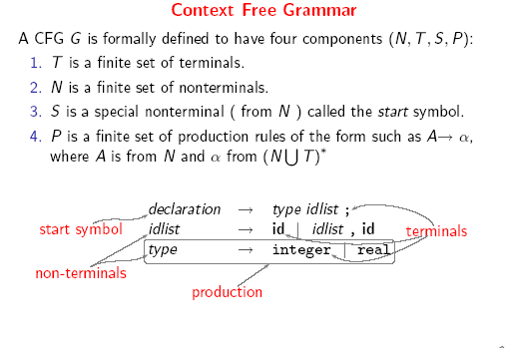
Compiler Design 40106

Slide 4
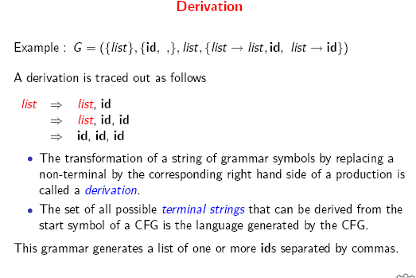
Compiler Design 40106

Slide 5
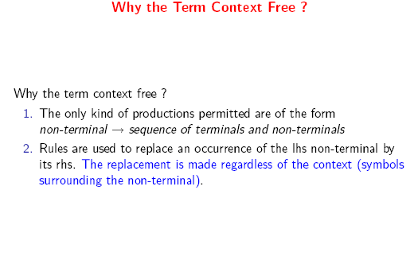
Compiler Design 40106

Slide 6
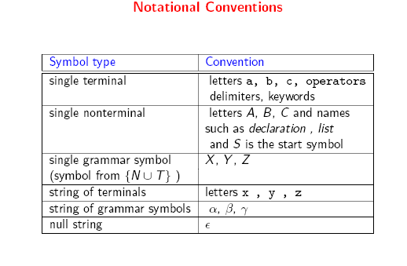
Compiler Design 40106

Slide 7
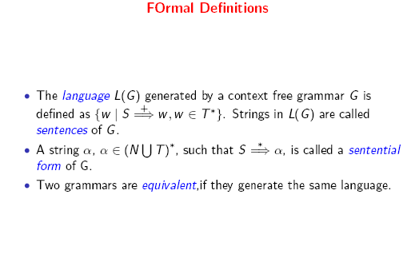
Compiler Design 40106

Slide 8
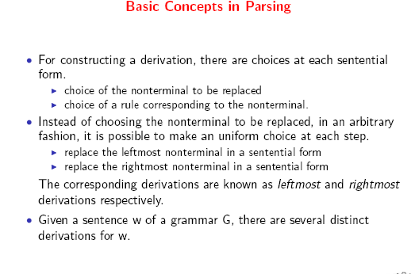
Compiler Design 40106

Slide 9
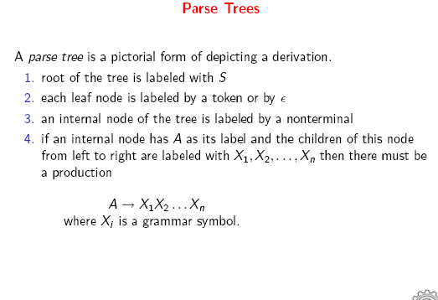
Compiler Design 40106

Slide 10
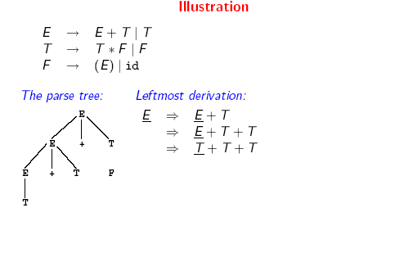
Compiler Design 40106

Slide 11
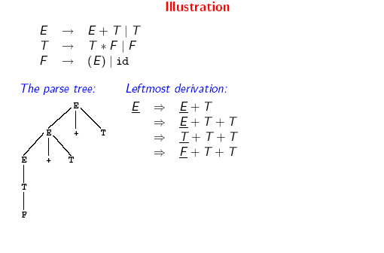
Compiler Design 40106

Slide 12
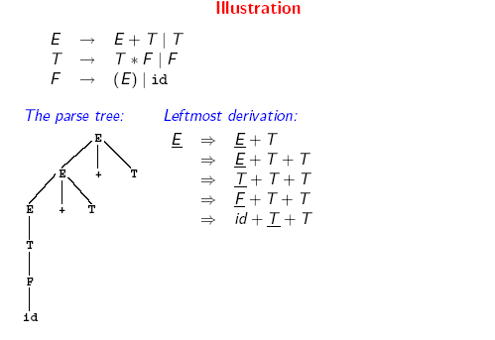
Compiler Design 40106

Slide 13
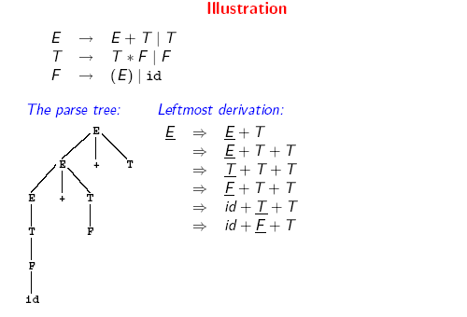
Compiler Design 40106

Slide 14
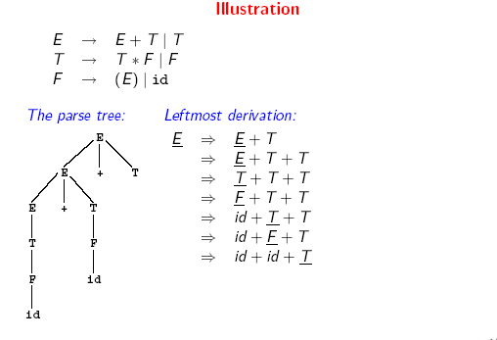
Compiler Design 40106

Slide 15
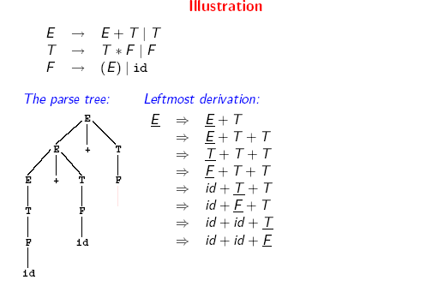
Compiler Design 40106

Slide 16
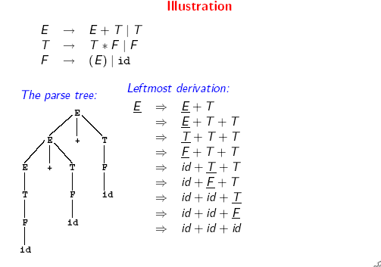
Compiler Design 40106

Slide 17
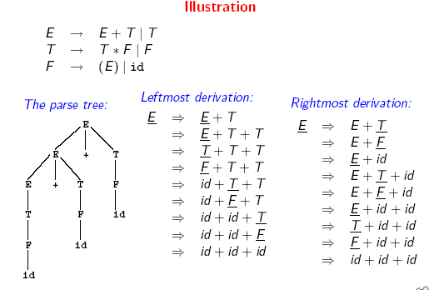
Compiler Design 40106

Slide 18
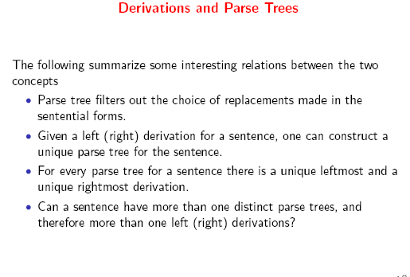
Compiler Design 40106

Slide 19
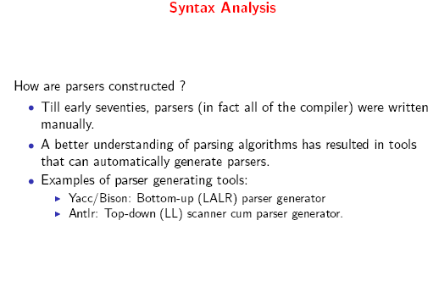
Compiler Design 40106

Slide 20
Parsers (cont.)
We categorize the parsers into two groups:
Top-Down Parser
  the parse tree is created top to bottom, starting from the root.
Bottom-Up Parser
  the parse is created bottom to top; starting from the leaves
Both top-down and bottom-up parsers scan the input from left to right (one symbol at a time).
Efficient top-down and bottom-up parsers can be implemented only for sub-classes of context-free grammars.
  LL for top-down parsing
  LR for bottom-up parsing
Compiler Design 40106

Slide 21
Ambiguity (cont.)
For the most parsers, the grammar must be unambiguous.
unambiguous grammar
➔ unique selection of the parse tree for a sentence
We should eliminate the ambiguity in the grammar during the design phase of the compiler.
An unambiguous grammar should be written to eliminate the ambiguity.
We have to prefer one of the parse trees of a sentence (generated by an ambiguous grammar) to disambiguate that grammar to restrict to this choice.
Compiler Design 40106

Slide 22
Ambiguity (cont.)
stmt → if expr then stmt |
if expr then stmt else stmt | otherstmts
if E₁ then if E₂ then S₁ else S₂
stmt
if expr then stmt else stmt
E₁ if expr then stmt S₂
E₂ S₁
stmt
if expr then stmt
E₁ if expr then stmt else stmt
E₂ S₁ S₂
1
2
Compiler Design 40106

Slide 23
Ambiguity (cont.)
We prefer the second parse tree (else matches with closest if).
So, we have to disambiguate our grammar to reflect this choice.
The unambiguous grammar will be:
stmt → matchedstmt | unmatchedstmt
matchedstmt → if expr then matchedstmt else matchedstmt | otherstmts
unmatchedstmt → if expr then stmt |
if expr then matchedstmt else unmatchedstmt
Compiler Design 40106

Slide 24
Left Recursion
A grammar is left recursive if it has a non-terminal A such that there is a derivation.
A ⇒ Aα for some string α
Top-down parsing techniques cannot handle left-recursive grammars.
So, we have to convert our left-recursive grammar into an equivalent grammar which is not left-recursive.
The left-recursion may appear in a single step of the derivation (immediate left-recursion), or may appear in more than one step of the derivation.
+
Compiler Design 40106

Slide 25
Immediate Left-Recursion
A → A α | β where β does not start with A
⇓ eliminate immediate left recursion
A → β A’
A’ → α A’ | ε an equivalent grammar
In general,
A → A α₁ | ... | A α_{m} | β₁ | ... | β_{n} where β₁ ... β_{n} do not start with A
⇓ eliminate immediate left recursion
A → β₁ A’ | ... | β_{n} A’
A’ → α₁ A’ | ... | α_{m} A’ | ε an equivalent grammar
Compiler Design 40106

Slide 26
Immediate Left-Recursion -- Example
E → E+T | T
T → T*F | F
F → id | (E)
⇓ eliminate immediate left recursion
E → T E’
E’ → +T E’ | ε
T → F T’
T’ → *F T’ | ε
F → id | (E)
Compiler Design 40106

Slide 27
Left-Factoring
A predictive parser (a top-down parser without backtracking) insists that the grammar must be left-factored.
grammar ➔ a new equivalent grammar suitable for predictive parsing
stmt → if expr then stmt else stmt |
if expr then stmt
when we see if, we cannot figure out which production rule to choose to re-write stmt in the derivation.
Compiler Design 40106

Slide 28
Left-Factoring (cont.)
In general,
A → αβ₁ | αβ₂ where α is non-empty and the first symbols
of β₁ and β₂ (if they have one)are different.
when processing α we cannot know whether expand
A to αβ₁ or
A to αβ₂
But, if we re-write the grammar as follows
A → αA’
A’ → β₁ | β₂ so, we can immediately expand A to αA’
Compiler Design 40106

Slide 29
Left-Factoring -- Algorithm
For each non-terminal A with two or more alternatives (production rules) with a common non-empty prefix, let us say
A → αβ₁ | ... | αβ_{n} | γ₁ | ... | γ_{m}
convert it into
A → αA’ | γ₁ | ... | γ_{m}
A’ → β₁ | ... | β_{n}
Compiler Design 40106

Slide 30
Left-Factoring – Example1
A → abB | aB | cdg | cdeB | cdfB
⇓
A → aA’ | cdg | cdeB | cdfB
A’ → bB | B
⇓
A → aA’ | cdA’’
A’ → bB | B
A’’ → g | eB | fB
Compiler Design 40106

Slide 31
Non-Context Free Language Constructs
There are some language constructs in the programming languages which are not context-free. This means that, we cannot write a context-free grammar for these constructs.
L1 = { ωcω | ω is in (a|b)*} is not context-free
➔ declaring an identifier and checking whether it is declared or not later. We cannot do this with a context-free language. We need semantic analyzer (which is not context-free).
L2 = {a^{n}b^{m}c^{n}d^{m} | n≥1 and m≥1 } is not context-free
➔ declaring two functions (one with n parameters, the other one with
m parameters), and then calling them with actual parameters.
Compiler Design 40106

Slide 32
Top-Down Parsing
The parse tree is created top to bottom.
Top-down parser
  Recursive-Descent Parsing
    Backtracking is needed (If a choice of a production rule does not work, we backtrack to try other alternatives.)
    It is a general parsing technique, but not widely used.
    Not efficient
  Predictive Parsing
    no backtracking
    efficient
    needs a special form of grammars (LL(1) grammars).
    Non-Recursive (Table Driven) Predictive Parser is also known as LL(1) parser.
Compiler Design 40106
Notes:
lec03-topdownparser

Slide 33
Recursive-Descent Parsing (uses Backtracking)
Backtracking is needed.
It tries to find the left-most derivation.
S → cAd
A → ab | a
S S
input: cad
c A d c A d
a b a
fails, backtrack
Compiler Design 40106

Slide 34
Predictive Parser
a grammar ➔ ➔ a grammar suitable for predictive
eliminate left parsing (a LL(1) grammar)
left recursion factor no %100 guarantee.
When re-writing a non-terminal in a derivation step, a predictive parser can uniquely choose a production rule by just looking the current symbol in the input string.
A → α₁ | ... | α_{n} input: ... a .......
current token
Compiler Design 40106

Slide 35
Predictive Parser (example)
stmt → if ...... |
while ...... |
begin ...... |
for .....
When we are trying to write the non-terminal stmt, if the current token is if we have to choose first production rule.
When we are trying to write the non-terminal stmt, we can uniquely choose the production rule by just looking the current token.
We eliminate the left recursion in the grammar, and left factor it. But it may not be suitable for predictive parsing (not LL(1) grammar).
Compiler Design 40106

Slide 36
Recursive Predictive Parsing
Each non-terminal corresponds to a procedure.
Ex: A → aBb (This is only the production rule for A)
proc A {
- match the current token with a, and move to the next token;
- call ‘B’;
- match the current token with b, and move to the next token;
}
Compiler Design 40106

Slide 37
Recursive Predictive Parsing (Example)
A → aBe | cBd | C
B → bB | ε
C → f
Compiler Design 40106

Slide 38
Non-Recursive Predictive Parsing -- LL(1) Parser
Non-Recursive predictive parsing is a table-driven parser.
It is a top-down parser.
It is also known as LL(1) Parser.
input buffer
stack Non-recursive output
Predictive Parser
Parsing Table
Compiler Design 40106

Slide 39
LL(1) Parser
input buffer
  our string to be parsed. We will assume that its end is marked with a special symbol $.
output
  a production rule representing a step of the derivation sequence (left-most derivation) of the string in the input buffer.
stack
  contains the grammar symbols
  at the bottom of the stack, there is a special end marker symbol $.
  initially the stack contains only the symbol $ and the starting symbol S. $S ⬅ initial stack
  when the stack is emptied (ie. only $ left in the stack), the parsing is completed.
parsing table
  a two-dimensional array M[A,a]
  each row is a non-terminal symbol
  each column is a terminal symbol or the special symbol $
  each entry holds a production rule.
Compiler Design 40106

Slide 40
LL(1) Parser – Parser Actions
The symbol at the top of the stack (say X) and the current symbol in the input string (say a) determine the parser action.
There are four possible parser actions.
If X and a are $ ➔ parser halts (successful completion)
If X and a are the same terminal symbol (different from $)
➔ parser pops X from the stack, and moves to the next symbol in the input buffer.
If X is a non-terminal
➔ parser looks at the parsing table entry M[X,a]. If M[X,a] holds a production rule X→Y₁Y₂...Y_{k}, it pops X from the stack and pushes Y_{k},Y_{k-1},...,Y₁ into the stack. The parser also outputs the production rule X→Y₁Y₂...Y_{k} to represent a step of the derivation.
none of the above ➔ error
  all empty entries in the parsing table are errors.
  If X is a terminal symbol different from a, this is also an error case.
Compiler Design 40106

Slide 41
LL(1) Parser – Example1
S → aBa LL(1) Parsing
B → bB | ε Table
stack input output
$S abba$ S → aBa
$aBa abba$
$aB bba$ B → bB
$aBb bba$
$aB ba$ B → bB
$aBb ba$
$aB a$ B → ε
$a a$
$ $ accept, successful completion
 | a | b | $
S | S → aBa
B | B → ε | B → bB
Compiler Design 40106

Slide 42
LL(1) Parser – Example1 (cont.)
Outputs: S → aBa B → bB B → bB B → ε
Derivation(left-most): S⇒aBa⇒abBa⇒abbBa⇒abba
S
parse tree
a
B
a
b
B
b
B
ε
Compiler Design 40106

Slide 43
LL(1) Parser – Example2
E → TE’
E’ → +TE’ | ε
T → FT’
T’ → *FT’ | ε
F → (E) | id
 | id | + | * | ( | ) | $
E | E → TE’ |  |  | E → TE’
E’ |  | E’ → +TE’ |  |  | E’ → ε | E’ → ε
T | T → FT’ |  |  | T → FT’
T’ |  | T’ → ε | T’ → *FT’ |  | T’ → ε | T’ → ε
F | F → id |  |  | F → (E)
Compiler Design 40106

Slide 44
LL(1) Parser – Example2
stack input output
$E id+id$ E → TE’
$E’T id+id$ T → FT’
$E’ T’F id+id$ F → id
$ E’ T’id id+id$
$ E’ T’ +id$ T’ → ε
$ E’ +id$ E’ → +TE’
$ E’ T+ +id$
$ E’ T id$ T → FT’
$ E’ T’ F id$ F → id
$ E’ T’id id$
$ E’ T’ $ T’ → ε
$ E’ $ E’ → ε
$ $ accept
Compiler Design 40106

Slide 45
Constructing LL(1) Parsing Tables
Two functions are used in the construction of LL(1) parsing tables:
  FIRST FOLLOW
FIRST(α) is a set of the terminal symbols which occur as first symbols in the strings derived from α where α is any string of grammar symbols.
if α derives to ε, then ε is also in FIRST(α) .
FOLLOW(A) is the set of the terminals which occur immediately after (follow) the non-terminal A in the strings derived from the starting symbol.
  a terminal a is in FOLLOW(A) if S ⇒ αAaβ
*
Compiler Design 40106

Slide 46
Compute FIRST for Any String X
If X is a terminal symbol ➔ FIRST(X)={X}
If X is a non-terminal symbol and X → ε is a production rule ➔ ε is in FIRST(X).
If X is a non-terminal symbol and X → Y₁Y₂..Y_{n} is a production rule ➔ if a terminal a in FIRST(Y_{i}) and ε is in all FIRST( Y_{j} ) for j=1,...,i-1 then a is in FIRST(X).
➔ if ε is in all FIRST(Y_{j}) for j=1,...,n then ε is in FIRST(X).
Compiler Design 40106

Slide 47
FIRST Example
E → TE’
E’ → +TE’ | ε
T → FT’
T’ → *FT’ | ε
F → (E) | id
FIRST(F) = {(,id} FIRST(TE’) = {(,id}
FIRST(T’) = {*, ε} FIRST(+TE’ ) = {+}
FIRST(T) = {(,id} FIRST(ε) = {ε}
FIRST(E’) = {+, ε} FIRST(FT’) = {(,id}
FIRST(E) = {(,id} FIRST(*FT’) = {*}
FIRST(ε) = {ε}
FIRST((E)) = {(}
FIRST(id) = {id}
Compiler Design 40106

Slide 48
Compute FOLLOW (for non-terminals)
If S is the start symbol ➔ $ is in FOLLOW(S)
if A → αBβ is a production rule ➔ everything in FIRST(β) is FOLLOW(B) except ε
If ( A → αB is a production rule ) or ( A → αBβ is a production rule and ε is in FIRST(β) ) ➔ everything in FOLLOW(A) is in FOLLOW(B).
We apply these rules until nothing more can be added to any follow set.
Compiler Design 40106

Slide 49
FOLLOW Example
E → TE’
E’ → +TE’ | ε
T → FT’
T’ → *FT’ | ε
F → (E) | id
FOLLOW(E) = { $, ) }
FOLLOW(E’) = { $, ) }
FOLLOW(T) = { +, ), $ }
FOLLOW(T’) = { +, ), $ }
FOLLOW(F) = {+, *, ), $ }
Compiler Design 40106

Slide 50
Constructing LL(1) Parsing Table -- Algorithm
for each production rule A → α of a grammar G
  for each terminal a in FIRST(α) ➔ add A → α to M[A,a]
  If ε in FIRST(α) ➔ for each terminal a in FOLLOW(A) add A → α to M[A,a]
  If ε in FIRST(α) and $ in FOLLOW(A) ➔ add A → α to M[A,$]
All other undefined entries of the parsing table are error entries.
Compiler Design 40106

Slide 51
Constructing LL(1) Parsing Table -- Example
E → TE’ FIRST(TE’)={(,id} ➔ E → TE’ into M[E,(] and M[E,id]
E’ → +TE’ FIRST(+TE’ )={+} ➔ E’ → +TE’ into M[E’,+]
E’ → ε FIRST(ε)={ε} ➔ none
but since ε in FIRST(ε)
and FOLLOW(E’)={$,)} ➔ E’ → ε into M[E’,$] and M[E’,)]
T → FT’ FIRST(FT’)={(,id} ➔ T → FT’ into M[T,(] and M[T,id]
T’ → *FT’ FIRST(*FT’ )={*} ➔ T’ → *FT’ into M[T’,*]
T’ → ε FIRST(ε)={ε} ➔ none
but since ε in FIRST(ε)
and FOLLOW(T’)={$,),+} ➔ T’ → ε into M[T’,$], M[T’,)] and M[T’,+]
F → (E) FIRST((E) )={(} ➔ F → (E) into M[F,(]
F → id FIRST(id)={id} ➔ F → id into M[F,id]
Compiler Design 40106

Slide 52
LL(1) Grammars
A grammar whose parsing table has no multiply-defined entries is said to be LL(1) grammar.
one input symbol used as a lookahead symbol do determine parser action
LL(1) left most derivation
input scanned from left to right
The parsing table of a grammar may contain more than one production rule. In this case, we say that it is not a LL(1) grammar.
Compiler Design 40106

Slide 53
A Grammar which is not LL(1)
S → i C t S E | a FOLLOW(S) = { $,e }
E → e S | ε FOLLOW(E) = { $,e }
C → b FOLLOW(C) = { t }
FIRST(iCtSE) = {i}
FIRST(a) = {a}
FIRST(eS) = {e}
FIRST(ε) = {ε}
FIRST(b) = {b}
two production rules for M[E,e]
Problem ➔ ambiguity
 | a | b | e | i | t | $
S | S → a |  |  | S → iCtSE
E |  |  | E → e S E → ε |  |  | E → ε
C |  | C → b
Compiler Design 40106

Slide 54
Properties of LL(1) Grammars
A grammar G is LL(1) if and only if the following conditions hold for two distinctive production rules A → α and A → β
  Both α and β cannot derive strings starting with same terminals.
  At most one of α and β can derive to ε.
  If β can derive to ε, then α cannot derive to any string starting with a terminal in FOLLOW(A).
Compiler Design 40106

Slide 55
Bottom-Up Parsing
A bottom-up parser creates the parse tree of the given input starting from leaves towards the root.
A bottom-up parser tries to find the right-most derivation of the given input in the reverse order.
  S ⇒ ... ⇒ ω (the right-most derivation of ω)
  ← (the bottom-up parser finds the right-most derivation in the reverse order)
Bottom-up parsing is also known as shift-reduce parsing because its two main actions are shift and reduce.
  At each shift action, the current symbol in the input string is pushed to a stack.
  At each reduction step, the symbols at the top of the stack (this symbol sequence is the right side of a production) will be replaced by the non-terminal at the left side of that production.
  There are also two more actions: accept and error.
Compiler Design 40106
Notes:
lec04-bottomupparser

Slide 56
Shift-Reduce Parsing
A shift-reduce parser tries to reduce the given input string into the starting symbol.
  a string ➔ the starting symbol
  reduced to
At each reduction step, a substring of the input matching to the right side of a production rule is replaced by the non-terminal at the left side of that production rule.
If the substring is chosen correctly, the right most derivation of that string is created in the reverse order.
Rightmost Derivation: S ⇒ ω
Shift-Reduce Parser finds: ω ⇐ ... ⇐ S
*
rm
rm
rm
Compiler Design 40106

Slide 57
Shift-Reduce Parsing -- Example
S → aABb input string: aaabb
A → aA | a aaAbb
B → bB | b aAbb ⇓ reduction
aABb
S
S ⇒ aABb ⇒ aAbb ⇒ aaAbb ⇒ aaabb
Right Sentential Forms
How do we know which substring to be replaced at each reduction step?
rm
rm
rm
rm
Compiler Design 40106

Slide 58
Handle
Informally, a handle of a string is a substring that matches the right side of a production rule.
  But not every substring matches the right side of a production rule is handle
A handle of a right sentential form γ (≡ αβω) is
a production rule A → β and a position of γ
where the string β may be found and replaced by A to produce
the previous right-sentential form in a rightmost derivation of γ.
S ⇒ αAω ⇒ αβω
If the grammar is unambiguous, then every right-sentential form of the grammar has exactly one handle.
We will see that ω is a string of terminals.(the string ω to the right of handle contains only terminal symbols.)
*
rm
rm
Compiler Design 40106

Slide 59
A Shift-Reduce Parser
E → E+T | T
T → T*F | F
F → (E) | id
Right-Most Sentential Form Reducing Production
id+id*id F → id
F+id*id T → F
---- ----
----- ----
----- -----
---- -----
Handles are red and underlined in the right-sentential forms.
Compiler Design 40106

Slide 60
A Shift-Reduce Parser
E → E+T | T Right-Most Derivation of id+id*id
T → T*F | F E ⇒ E+T ⇒ E+T*F ⇒ E+T*id ⇒ E+F*id
F → (E) | id ⇒ E+id*id ⇒ T+id*id ⇒ F+id*id ⇒ id+id*id
Right-Most Sentential Form Reducing Production
id+id*id F → id
F+id*id T → F
T+id*id E → T
E+id*id F → id
E+F*id T → F
E+T*id F → id
E+T*F T → T*F
E+T E → E+T
E
Handles are red and underlined in the right-sentential forms.
Compiler Design 40106

Slide 61
A Stack Implementation of A Shift-Reduce Parser
There are four possible actions of a shift-parser action:
  Shift : The next input symbol is shifted onto the top of the stack.
  Reduce: Replace the handle on the top of the stack by the non-terminal.
  Accept: Successful completion of parsing.
  Error: Parser discovers a syntax error, and calls an error recovery routine.
Initial stack just contains only the end-marker $.
The end of the input string is marked by the end-marker $.
Compiler Design 40106

Slide 62
A Stack Implementation of A Shift-Reduce Parser
Stack Input Action
$ id+id*id$ shift
$id +id*id$ reduce by F → id Parse Tree
$F +id*id$ reduce by T → F
$T +id*id$ reduce by E → T E 8
$E +id*id$ shift
$E+ id*id$ shift E 3 + T 7
$E+id *id$ reduce by F → id
$E+F *id$ reduce by T → F T 2 T 5 * F 6
$E+T *id$ shift
$E+T* id$ shift F 1 F 4 id
$E+T*id $ reduce by F → id
$E+T*F $ reduce by T → T*F id id
$E+T $ reduce by E → E+T
$E $ accept
Compiler Design 40106
Notes:
Grammer:
E->E+T|T
T->T*F|F
F->id
lec02-parserCFG

Slide 63
LR Parsers
The most powerful shift-reduce parsing (yet efficient) is:
LR(k) parsing.
left to right right-most k lookhead
scanning derivation in reverse (k is omitted ➔ it is 1)
LR parsing is attractive because:
  LR parsing is most general non-backtracking shift-reduce parsing.
  The class of grammars that can be parsed using LR methods is a proper superset of the class of grammars that can be parsed with predictive parsers. LL(1)-Grammars ⊂ LR(1)-Grammars
  An LR-parser can detect a syntactic error as soon as it is possible to do so a left-to-right scan of the input.
  LR parsers recognize virtually all programming-language constructs for which CFG can be written.
Compiler Design 40106

Slide 64
LR Parsers
LR-Parsers
  covers wide range of grammars.
  SLR – simple LR parser
  LR(CLR) – most general LR parser
  LALR – intermediate LR parser (look-head LR parser)
  SLR, CLR and LALR work same (they used the same algorithm), only their parsing tables are different.
Compiler Design 40106

Slide 65
LR Parsing Algorithm
input
a₁ | ... | a_{i} | ... | a_{n} | $
stack
S_{m}
X_{m}
S_{m-1}
X_{m-1}
.
.
S₁
X₁
S₀
LR Parsing Algorithm
output
Action Table terminals and $ s t four different a actions t e s | Goto Table non-terminal s t each item is a a state number t e s
Compiler Design 40106

Slide 66
A Configuration of LR Parsing Algorithm
A configuration of a LR parsing is:
( S_{o} X₁ S₁ ... X_{m} S_{m}, a_{i} a_{i+1} ... a_{n} $ )
Stack Rest of Input
S_{m} and a_{i} decides the parser action by consulting the parsing action table. (Initial Stack contains just S_{o} )
A configuration of a LR parsing represents the right sentential form:
X₁ ... X_{m} a_{i} a_{i+1} ... a_{n} $
Compiler Design 40106

Slide 67
Actions of A LR-Parser
shift s -- shifts the next input symbol and the state s onto the stack
( S_{o} X₁ S₁ ... X_{m} S_{m}, a_{i} a_{i+1} ... a_{n} $ ) ➔ ( S_{o} X₁ S₁ ... X_{m} S_{m} a_{i} s, a_{i+1} ... a_{n} $ )
reduce A→β (or r_{n} where n is a production number)
  pop 2|β| (r is the length of β) items from the stack;
  then push A and s where s=goto[s_{m-r},A]
( S_{o} X₁ S₁ ... X_{m} S_{m}, a_{i} a_{i+1} ... a_{n} $ ) ➔ ( S_{o} X₁ S₁ ... X_{m-r} S_{m-r} A s, a_{i} ... a_{n} $ )
  Output is the reducing production reduce A→β
Accept – Parsing successfully completed
Error -- Parser detected an error (an empty entry in the action table)
Compiler Design 40106

Slide 68
Reduce Action
pop 2|β| (r is the length of β ) items from the stack;
let us assume that β = Y₁Y₂...Y_{r}
then push A and s where s=goto[s_{m-r},A]
( S_{o} X₁ S₁ ... X_{m-r} S_{m-r} Y₁ S_{m-r+1} ...Y_{r} S_{m}, a_{i} a_{i+1} ... a_{n} $ )
➔ ( S_{o} X₁ S₁ ... X_{m-r} S_{m-r} A s, a_{i} ... a_{n} $ )
In fact, Y₁Y₂...Y_{r} is a handle.
X₁ ... X_{m-r} A a_{i} ... a_{n} $ ⇒ X₁ ... X_{m} Y₁...Y_{r} a_{i} a_{i+1} ... a_{n} $
Compiler Design 40106

Slide 69
The LR parsing algorithm
At each step, the parser is in some configuration.
The next move depends on reading a_{i} from the input and s_{m} from the top of the stack.
  If action[s_{m},a_{i}] = shift s, we execute a SHIFT move, entering the configuration ( s₀ X₁ s₁ … X_{m} s_{m} a_{i} s, a_{i+1} … a_{n} $ ).
  If action[s_{m},a_{i}] = reduce A -> β, then we enter the configuration
  ( s₀ X₁ s₁ … X_{m-r} s_{m-r} A s, a_{i+1} … a_{n} $ ),
  where r = | β | and s = goto[s_{m-r},A].
  Output the production A → β
  If action[s_{m},a_{i}] = accept, we’re done.
  If action[s_{m},a_{i}] = error, we call an error recovery routine.
Compiler Design 40106

Slide 70
(SLR) Parsing Tables for Expression Grammar
Action Table
Goto Table
1) E → E+T
2) E → T
3) T → T*F
4) T → F
5) F → (E)
6) F → id
state | id | + | * | ( | ) | $ |  | E | T | F
0 | s5 |  |  | s4 |  |  |  | 1 | 2 | 3
1 |  | s6 |  |  |  | acc
2 |  | r2 | s7 |  | r2 | r2
3 |  | r4 | r4 |  | r4 | r4
4 | s5 |  |  | s4 |  |  |  | 8 | 2 | 3
5 |  | r6 | r6 |  | r6 | r6
6 | s5 |  |  | s4 |  |  |  |  | 9 | 3
7 | s5 |  |  | s4 |  |  |  |  |  | 10
8 |  | s6 |  |  | s11
9 |  | r1 | s7 |  | r1 | r1
10 |  | r3 | r3 |  | r3 | r3
11 |  | r5 | r5 |  | r5 | r5
Compiler Design 40106

Slide 71
Actions of A (S)LR-Parser -- Example
stack input action output
0 id*id+id$ shift 5
0id5 *id+id$ reduce by F→id F→id
0F3 *id+id$ reduce by T→F T→F
0T2 *id+id$ shift 7
0T2*7 id+id$ shift 5
0T2*7id5 +id$ reduce by F→id F→id
0T2*7F10 +id$ reduce by T→T*F T→T*F
0T2 +id$ reduce by E→T E→T
0E1 +id$ shift 6
0E1+6 id$ shift 5
0E1+6id5 $ reduce by F→id F→id
0E1+6F3 $ reduce by T→F T→F
0E1+6T9 $ reduce by E→E+T E→E+T
0E1 $ accept
Compiler Design 40106

Slide 72
Constructing SLR Parsing Tables – LR(0) Item
An LR(0) item of a grammar G is a production of G a dot at the some position of the right side.
Ex: A → aBb Possible LR(0) Items: A → .aBb
(four different possibility) A → a.Bb
A → aB.b
A → aBb.
Sets of LR(0) items will be the states of action and goto table of the SLR parser.
A collection of sets of LR(0) items (the canonical LR(0) collection) is the basis for constructing SLR parsers.
Augmented Grammar:
G’ is G with a new production rule S’→S where S’ is the new starting symbol.
Compiler Design 40106

Slide 73
The Closure Operation
If I is a set of LR(0) items for a grammar G, then closure(I) is the set of LR(0) items constructed from I by the two rules:
  Initially, every LR(0) item in I is added to closure(I).
  If A → α.Bβ is in closure(I) and B→γ is a production rule of G; then B→.γ will be in the closure(I). We will apply this rule until no more new LR(0) items can be added to closure(I).
Compiler Design 40106

Slide 74
The Closure Operation -- Example
E’ → E closure({E’ → .E}) = ?
E → E+T
E → T
T → T*F
T → F
F → (E)
F → id
Compiler Design 40106

Slide 75
The Closure Operation -- Example
E’ → E closure({E’ → .E}) =
E → E+T { E’ → .E kernel items
E → T E → .E+T
T → T*F E → .T
T → F T → .T*F
F → (E) T → .F
F → id F → .(E)
F → .id }
Compiler Design 40106

Slide 76
Goto Operation
If I is a set of LR(0) items and X is a grammar symbol (terminal or non-terminal), then goto(I,X) is defined as follows:
  If A → α.Xβ in I then every item in closure({A → αX.β}) will be in goto(I,X).
Example:
I ={ E’ → .E, E → .E+T, E → .T,
T → .T*F, T → .F,
F → .(E), F → .id }
goto(I,E) = { ----------}
goto(I,T) = { -----------}
goto(I,F) = {------------}
goto(I,() = { ---------- }
goto(I,id) = {----------}
Compiler Design 40106

Slide 77
Goto Operation
If I is a set of LR(0) items and X is a grammar symbol (terminal or non-terminal), then goto(I,X) is defined as follows:
  If A → α.Xβ in I then every item in closure({A → αX.β}) will be in goto(I,X).
Example:
I ={ E’ → .E, E → .E+T, E → .T,
T → .T*F, T → .F,
F → .(E), F → .id }
goto(I,E) = { E’ → E., E → E.+T }
goto(I,T) = { E → T., T → T.*F }
goto(I,F) = {T → F. }
goto(I,() = { F → (.E), E → .E+T, E → .T, T → .T*F, T → .F,
F → .(E), F → .id }
goto(I,id) = { F → id. }
Compiler Design 40106

Slide 78
Construction of The Canonical LR(0) Collection
To create the SLR parsing tables for a grammar G, we will create the canonical LR(0) collection of the grammar G’.
Algorithm:
  C is { closure({S’→.S}) }
  repeat the followings until no more set of LR(0) items can be added to C.
    for each I in C and each grammar symbol X
      if goto(I,X) is not empty and not in C
        add goto(I,X) to C
goto function is a DFA on the sets in C.
Compiler Design 40106

Slide 79
The Canonical LR(0) Collection -- Example
I₀: E’ → .E I₆: E → E+.T I₉: E → E+T.
E → .E+T T → .T*F T → T.*F
E → .T T → .F
T → .T*F I₂: E → T. F → .(E) I₁₀: T → T*F.
T → .F T → T.*F F → .id
F → .(E)
F → .id I₃: T → F. I₇: T → T*.F I₁₁: F → (E).
F → .(E)
I₁: E’ → E. I₄: F → (.E) F → .id
E → E.+T E → .E+T
E → .T I₈: F → (E.)
T → .T*F E → E.+T
T → .F
F → .(E)
F → .id
I₅: F → id.
Compiler Design 40106

Slide 80
Parsing Tables of Expression Grammar
Action Table
Goto Table
state | id | + | * | ( | ) | $ |  | E | T | F
0 | s5 |  |  | s4 |  |  |  | 1 | 2 | 3
1 |  | s6 |  |  |  | acc
2 |  | r2 | s7 |  | r2 | r2
3 |  | r4 | r4 |  | r4 | r4
4 | s5 |  |  | s4 |  |  |  | 8 | 2 | 3
5 |  | r6 | r6 |  | r6 | r6
6 | s5 |  |  | s4 |  |  |  |  | 9 | 3
7 | s5 |  |  | s4 |  |  |  |  |  | 10
8 |  | s6 |  |  | s11
9 |  | r1 | s7 |  | r1 | r1
10 |  | r3 | r3 |  | r3 | r3
11 |  | r5 | r5 |  | r5 | r5
Compiler Design 40106

Slide 81
SLR(1) Grammar
An LR parser using SLR parsing tables for a grammar G is called as the SLR parser for G.
If a grammar G has an SLR parsing table, it is called SLR grammar (or SLR grammar in short).
Every SLR grammar is unambiguous, but every unambiguous grammar is not a SLR grammar.
Compiler Design 40106

Slide 82
Conflict Example
S → L=R I₀: S’ → .S I₁: S’ → S. I₆: S → L=.R I₉: S → L=R.
S → R S → .L=R R → .L
L→ *R S → .R I₂: S → L.=R L→ .*R
L → id L → .*R R → L. L → .id
R → L L → .id
R → .L I₃: S → R.
I₄: L → *.R I₇: L → *R.
Problem R → .L
FOLLOW(R)={=,$} L→ .*R I₈: R → L.
= shift 6 L → .id
reduce by R → L
shift/reduce conflict I₅: L → id.
Compiler Design 40106

Slide 83
Conflict Example2
S → AaAb I₀: S’ → .S
S → BbBa S → .AaAb
A → ε S → .BbBa
B → ε A → .
B → .
Problem
FOLLOW(A)={a,b}
FOLLOW(B)={a,b}
a reduce by A → ε b reduce by A → ε
reduce by B → ε reduce by B → ε
reduce/reduce conflict reduce/reduce conflict
Compiler Design 40106

Slide 84
Canonical Collection of Sets of LR(1) Items
The construction of the canonical collection of the sets of LR(1) items are similar to the construction of the canonical collection of the sets of LR(0) items, except that closure and goto operations work a little bit different.
closure(I) is: ( where I is a set of LR(1) items)
  every LR(1) item in I is in closure(I)
  if A→α.Bβ,a in closure(I) and B→γ is a production rule of G; then B→.γ,b will be in the closure(I) for each terminal b in FIRST(βa) .
Compiler Design 40106

